Slide 1
Hnefatafl
BetterByte
Carson Tunnell
Dan McClure
John Pokorski
Hayden Cannalte
Devin Dennis

Slide 2
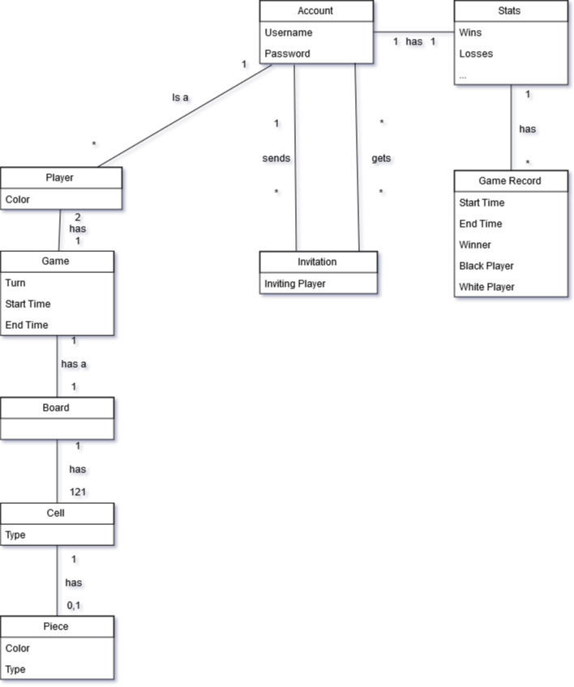
Domain Model

Slide 3
Questions?

